Slide 1
Good Morning

Slide 2
Content
Control Statement
Types of Control Statement
Conditional Statements
Types of Conditional Statements
Looping statements.
Types of Looping statements.
What is Array
Indexing in Array
Array Syntax

Slide 3
Control Statements
Java compiler executes the code from top to bottom. The statements in the code are executed according to the order in which they appear.
Java provides statements that can be used to control the flow of Java code. Such statements are called control flow statements.
Types of Control Statements
Conditional Statement
Looping or iterative statements.

Slide 4
Conditional Statements
Conditional statements are mostly used in decision-making scenarios which means these statements take a decision on the basis of some conditions.
Use if to specify a block of code to be executed, if a specified condition is true
If the First condition is False then else part executed.

Slide 5
Types of Conditional Statements
Simple if
If the given condition is true then the statements inside the body of “if” will be executed.
if else
Use if to specify a block of code to be executed, if a specified condition is true. Use else to specify a block of code to be executed, if the First or same condition is false.
else if ladder
In if-else-if ladder statement, if a condition is true then the statements defined in the if block will be executed, otherwise if some other condition is true then the statements defined in the else-if block will be executed,
Nested if
Nested IF functions, meaning one IF function inside of another, allows you to test multiple criteria and increases the number of possible outcomes. Nested IF functions, meaning one IF function inside of another, allows you to test multiple criteria and increases the number of possible outcomes.
Switch case
The Java switch statement executes one statement from multiple conditions. Switch case statement evaluates a given expression and based on the evaluated value(matching a certain condition),

Slide 6
Looping statements.
To execute the block of code repeatedly while some condition evaluates to true.
Loop statements are used to execute the set of instructions in a repeated order.

Slide 7
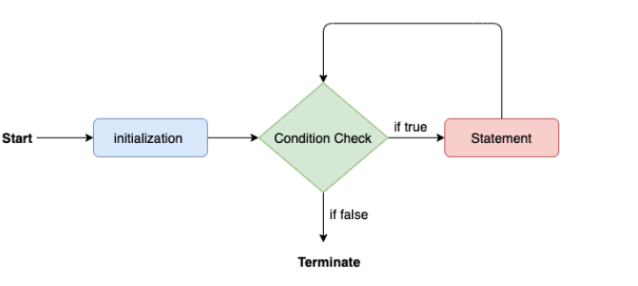
Types of Looping statements.
for loop (use when known the number of iteration)
Syntax of for loop
for(init;condition;incr/decr)
{
// code to be executed
}

Slide 8
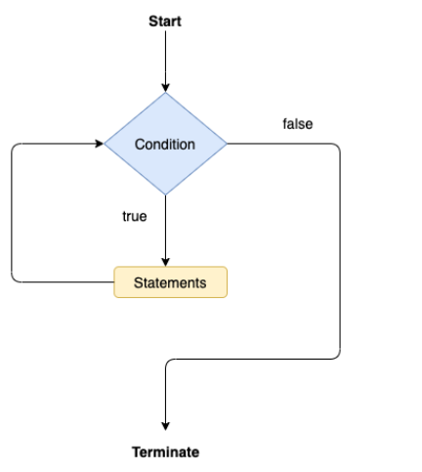
Looping statements.
while loop(use when known the number of iteration)
Syntax for While loop
init
while(condition){
//code to be executed.
Decrement/increment
}

Slide 9
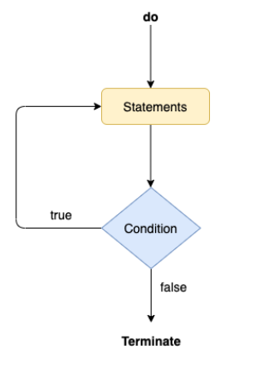
Looping statements.
do-while loop (use when known the number of iteration)
Syntax of do while loop
Init;
do {
// statements
Increment/decrement
}
while (expression);

Slide 10
What is Array
Array is a object
It is a non primitive data type
Collection of similar type of data
Collection of similar value

Slide 11
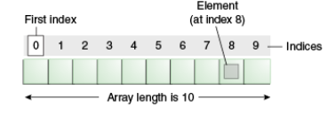
Indexing in Array

Slide 12
Array Syntax
For String
String a[] = new String[100];
For integer
int a[]=new int[5];

Slide 13
Thanks

